Slide 1
YOLO custom data trainig Report Dataset:korean high-way vehicle dataset
Yogendra Rao M

Slide 2
Overview
YOLO5s model
Trained using custom korean highway dataset

Slide 3
Train custom data

Slide 4
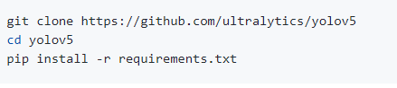
Train custom data 1. Clone repo and install requirements.txt in a Python>=3.6.0 environment, including PyTorch >= 1.7. Models and datasets download automatically from the latest YOLOv5 release. 2. To train custom data, it needs (a).Create dataset.yaml (b).Create labels

Slide 5
1.Create dataset.yaml
It is created in notepad with the .yaml extenstion.
# Train/val/test sets as 1) dir: path/to/imgs, 2) file: path/to/imgs.txt, or 3) list: [path/to/imgs1, path/to/imgs2, ..]
path: ../Vehicle dataset_03/vehicle_dataset # dataset root dir
train: images # train images (relative to 'path') 128 images
val: images # val images (relative to 'path') 128 images
test: # test images (optional)
# Classes
nc: 4 # number of classes
names: ['Car', 'Truck', 'Speed_limit sign', 'Traffic_sign'] # class names

Slide 6
2.Create Labels
Labels are created using the makesense.ai software to label images, export your labels to YOLO format with one *.txt file per image.
# The *.txt file specifications are
(a). One row per object
(b). Each row is “class x_center y_center width height “ format
(c). Box coordinates must be in normalized xywh format (from 0 - 1). If your boxes are in pixels, divide x_center and width by image width, and y_center and height by image height.
(d). Class numbers are zero-indexed (start from 0).

Slide 7
Train custom data

Slide 8
Train custom data 1. We created the custom Korean highway vehicle dataset consists of 281 images and 281 labels. 2.We used same images for validation also. 3. This is only for testing the custom dataset to test our own dataset. 4. The vehicle dataset consists of 3168 images. These images are used for testing. Trained on: google collab GPU server.

Slide 9
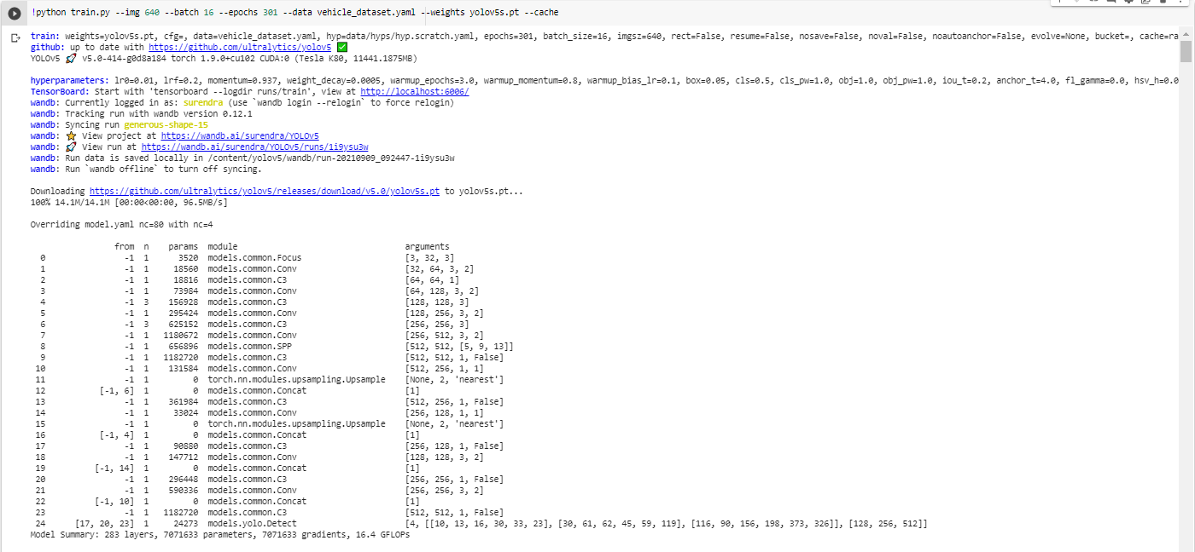
Training details:

Slide 10
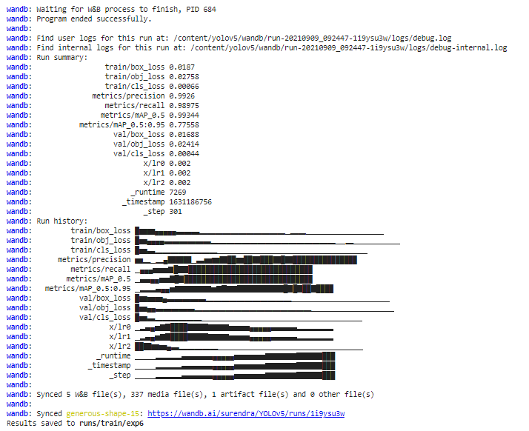
Training details:

Slide 11
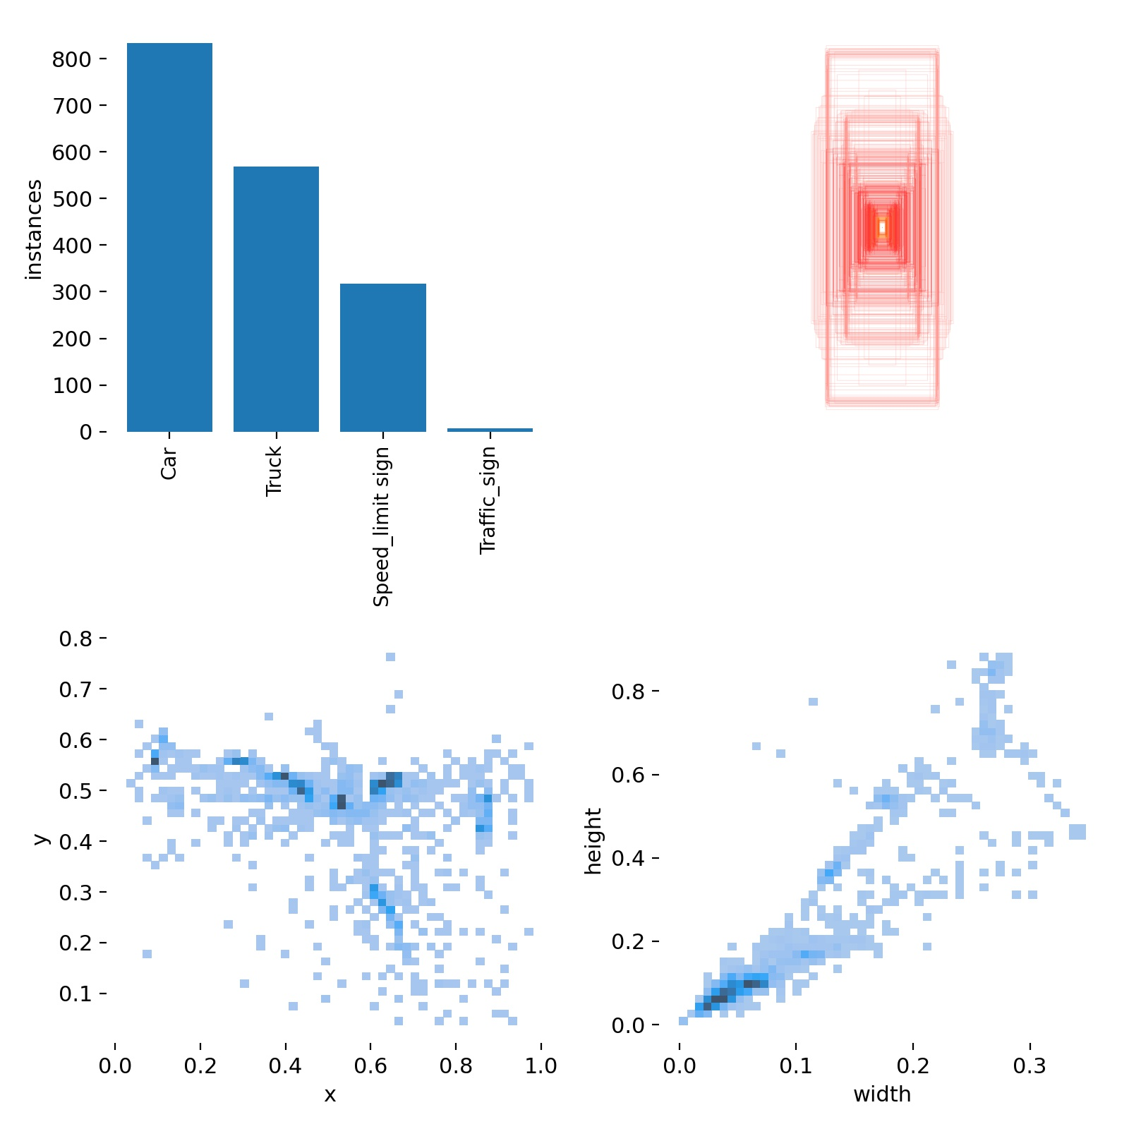
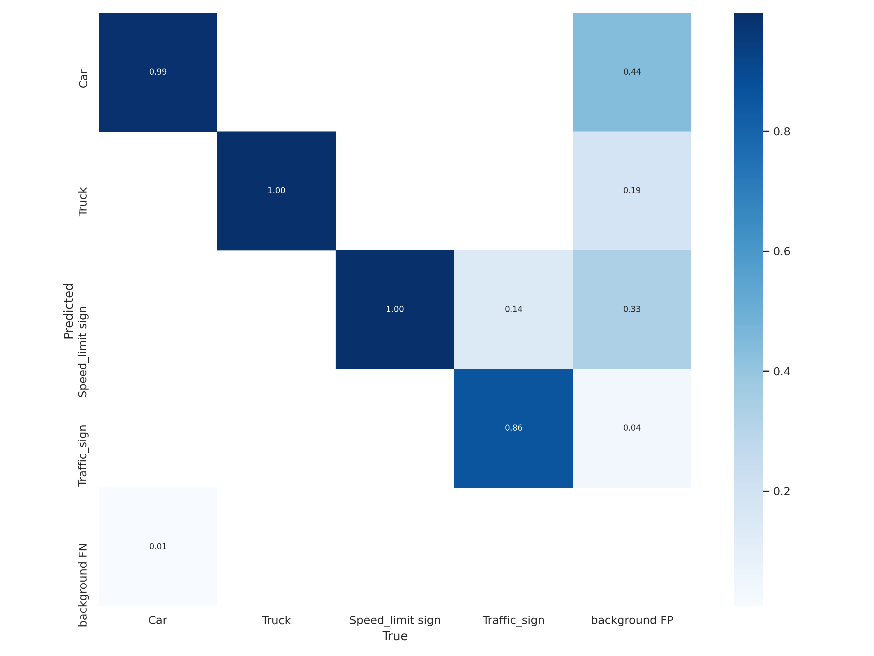
Results of training:
Confusion Matrix
labels

Slide 12
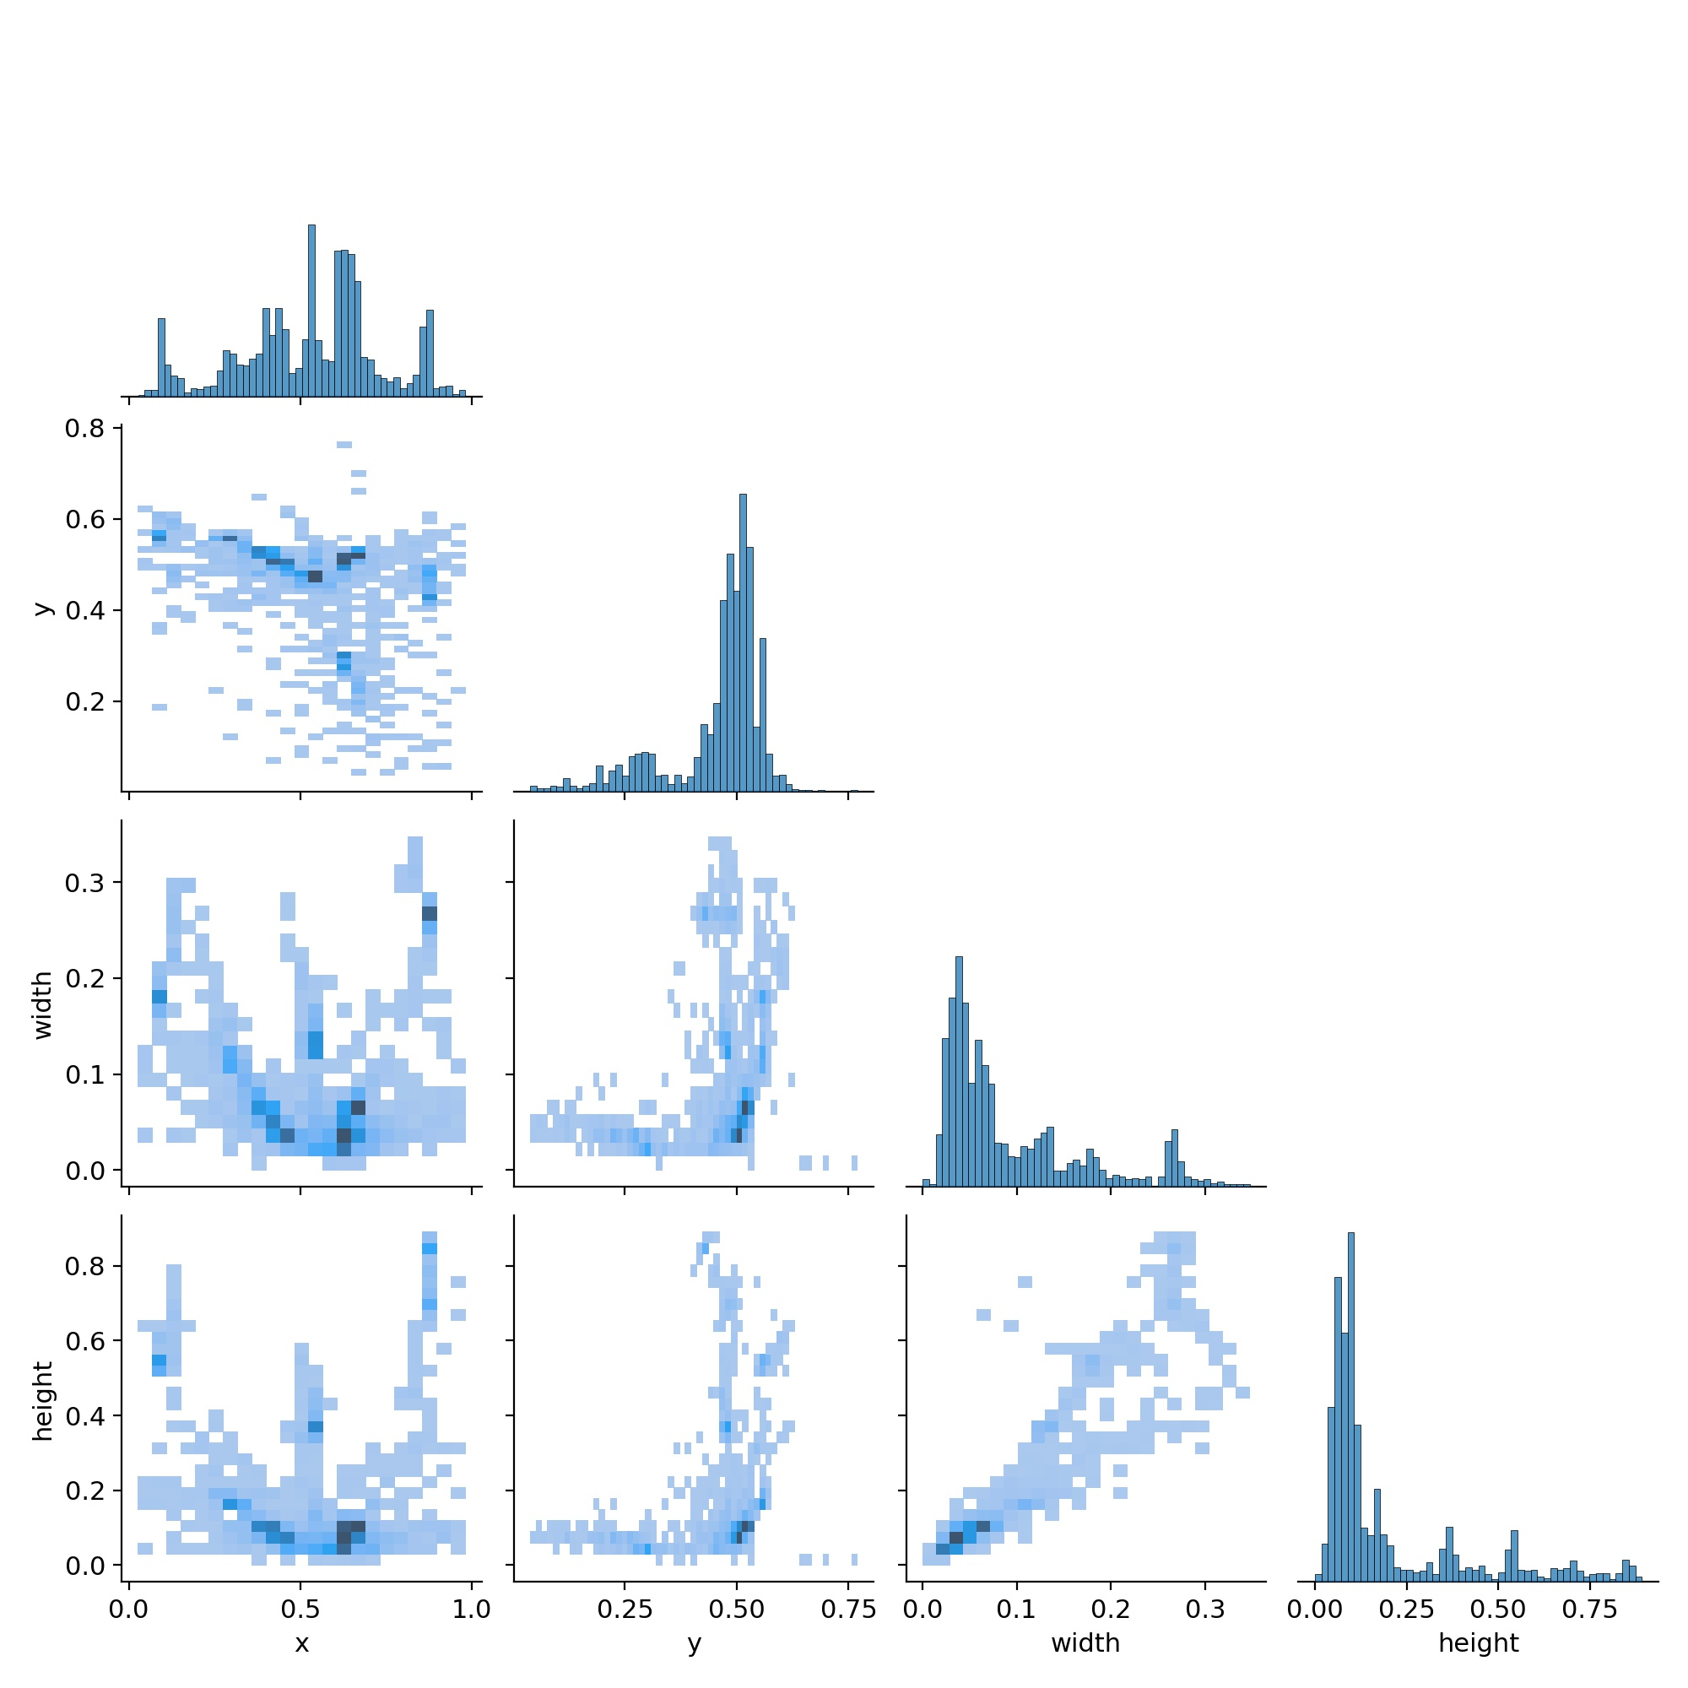
Labels_Correlogram

Slide 13
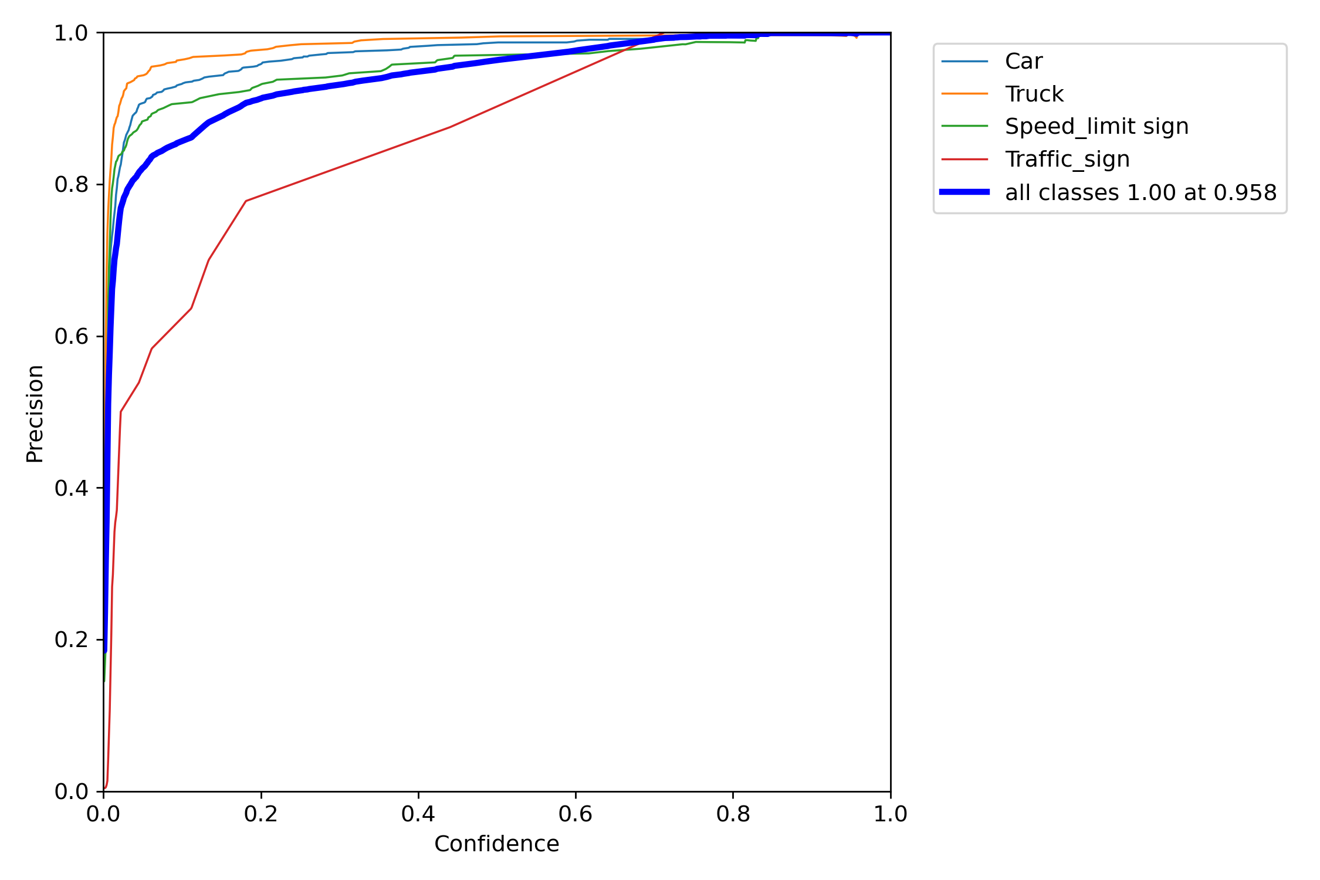
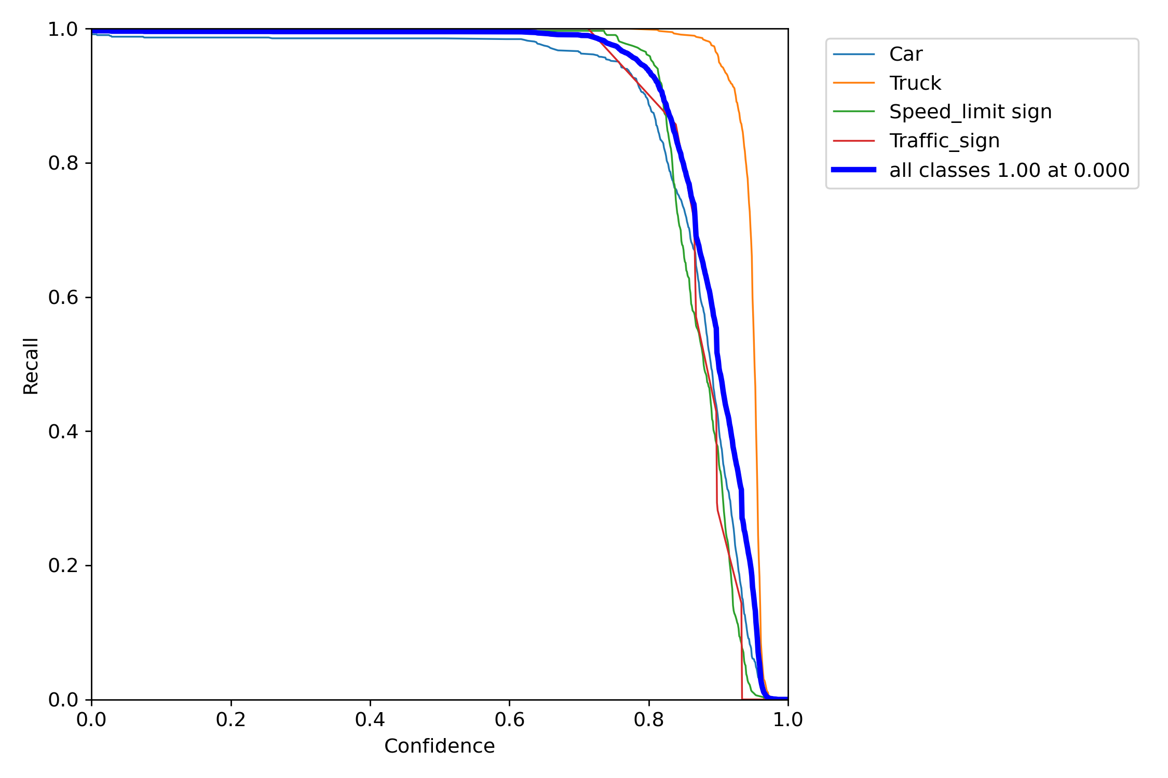
Graphs:
P_Curve
R_Curve

Slide 14
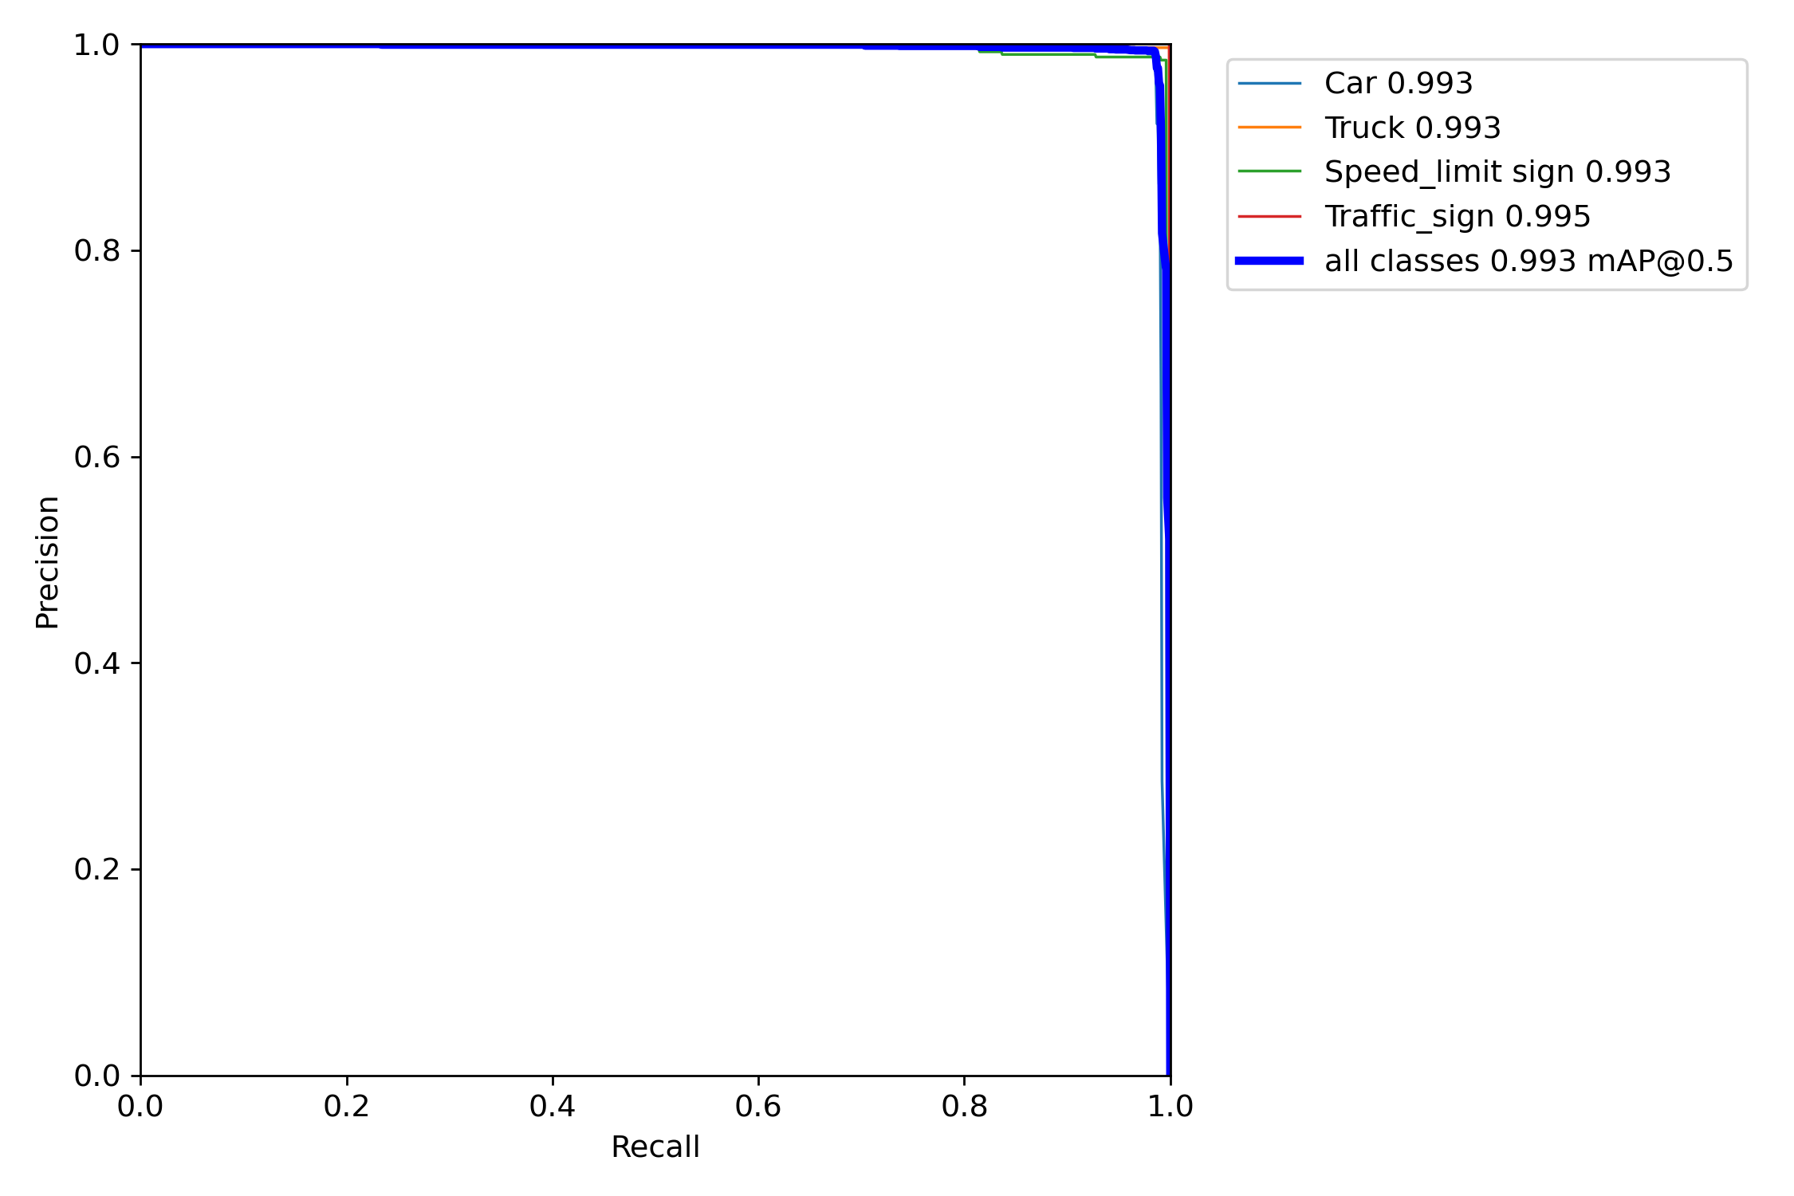
Graphs:
PR_Curve

Slide 15
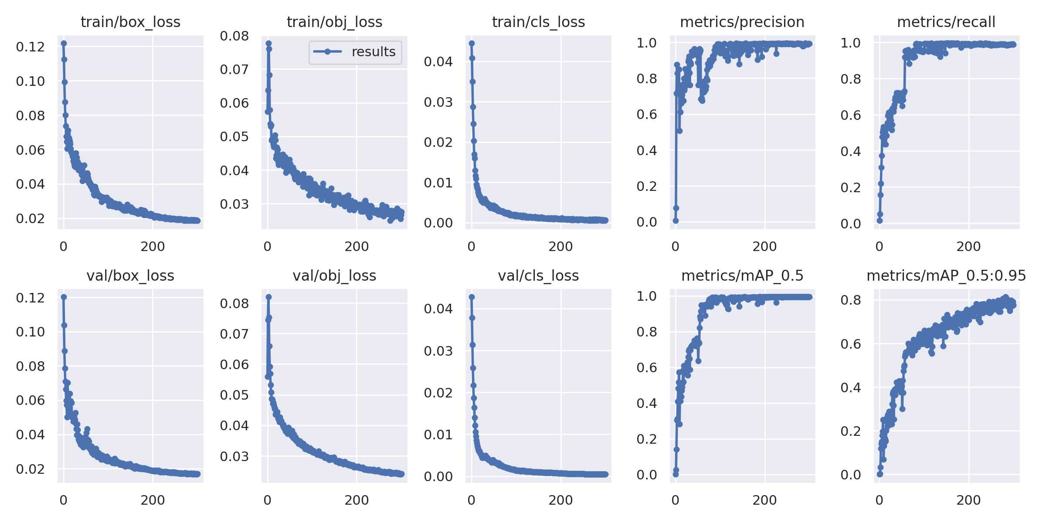
Results graph:

Slide 16
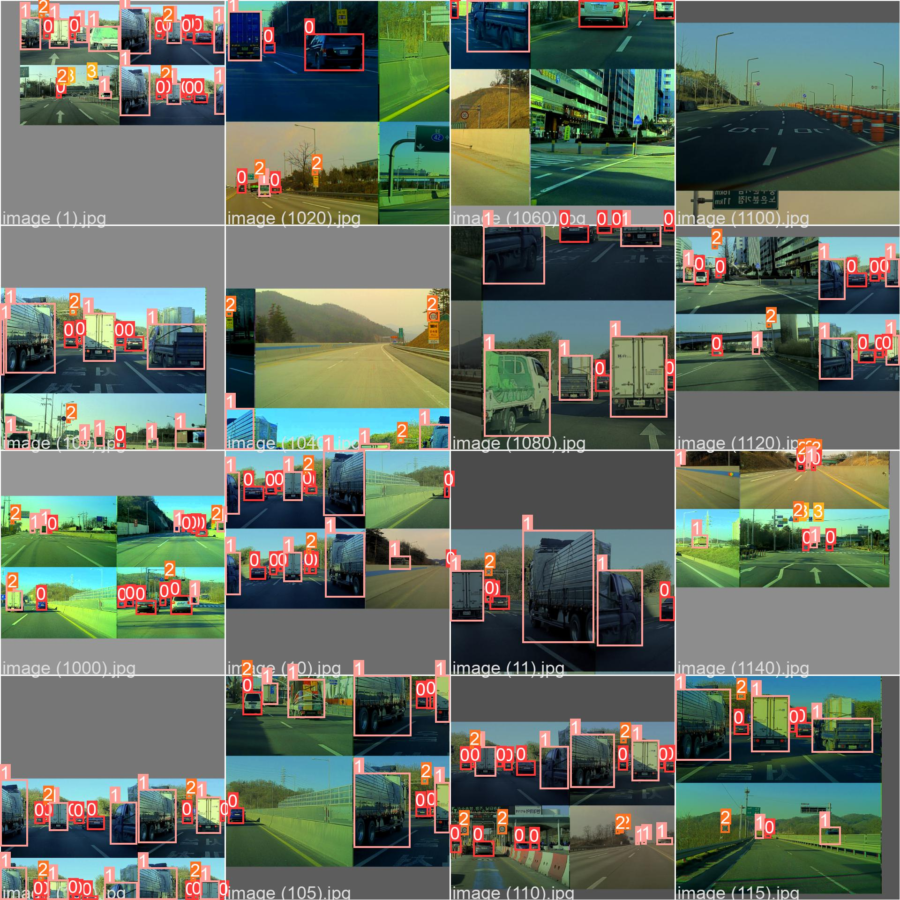
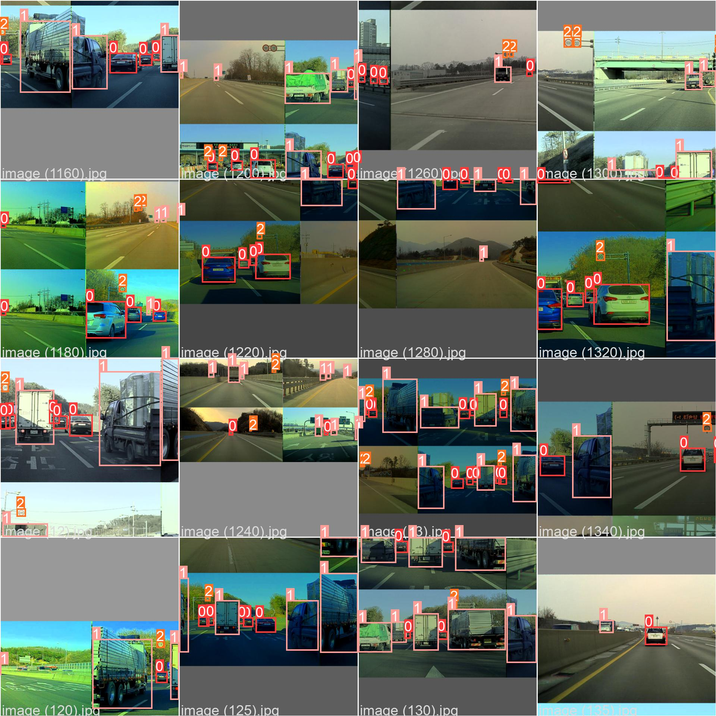
While training:
Train_batch0
Train_batch1

Slide 17
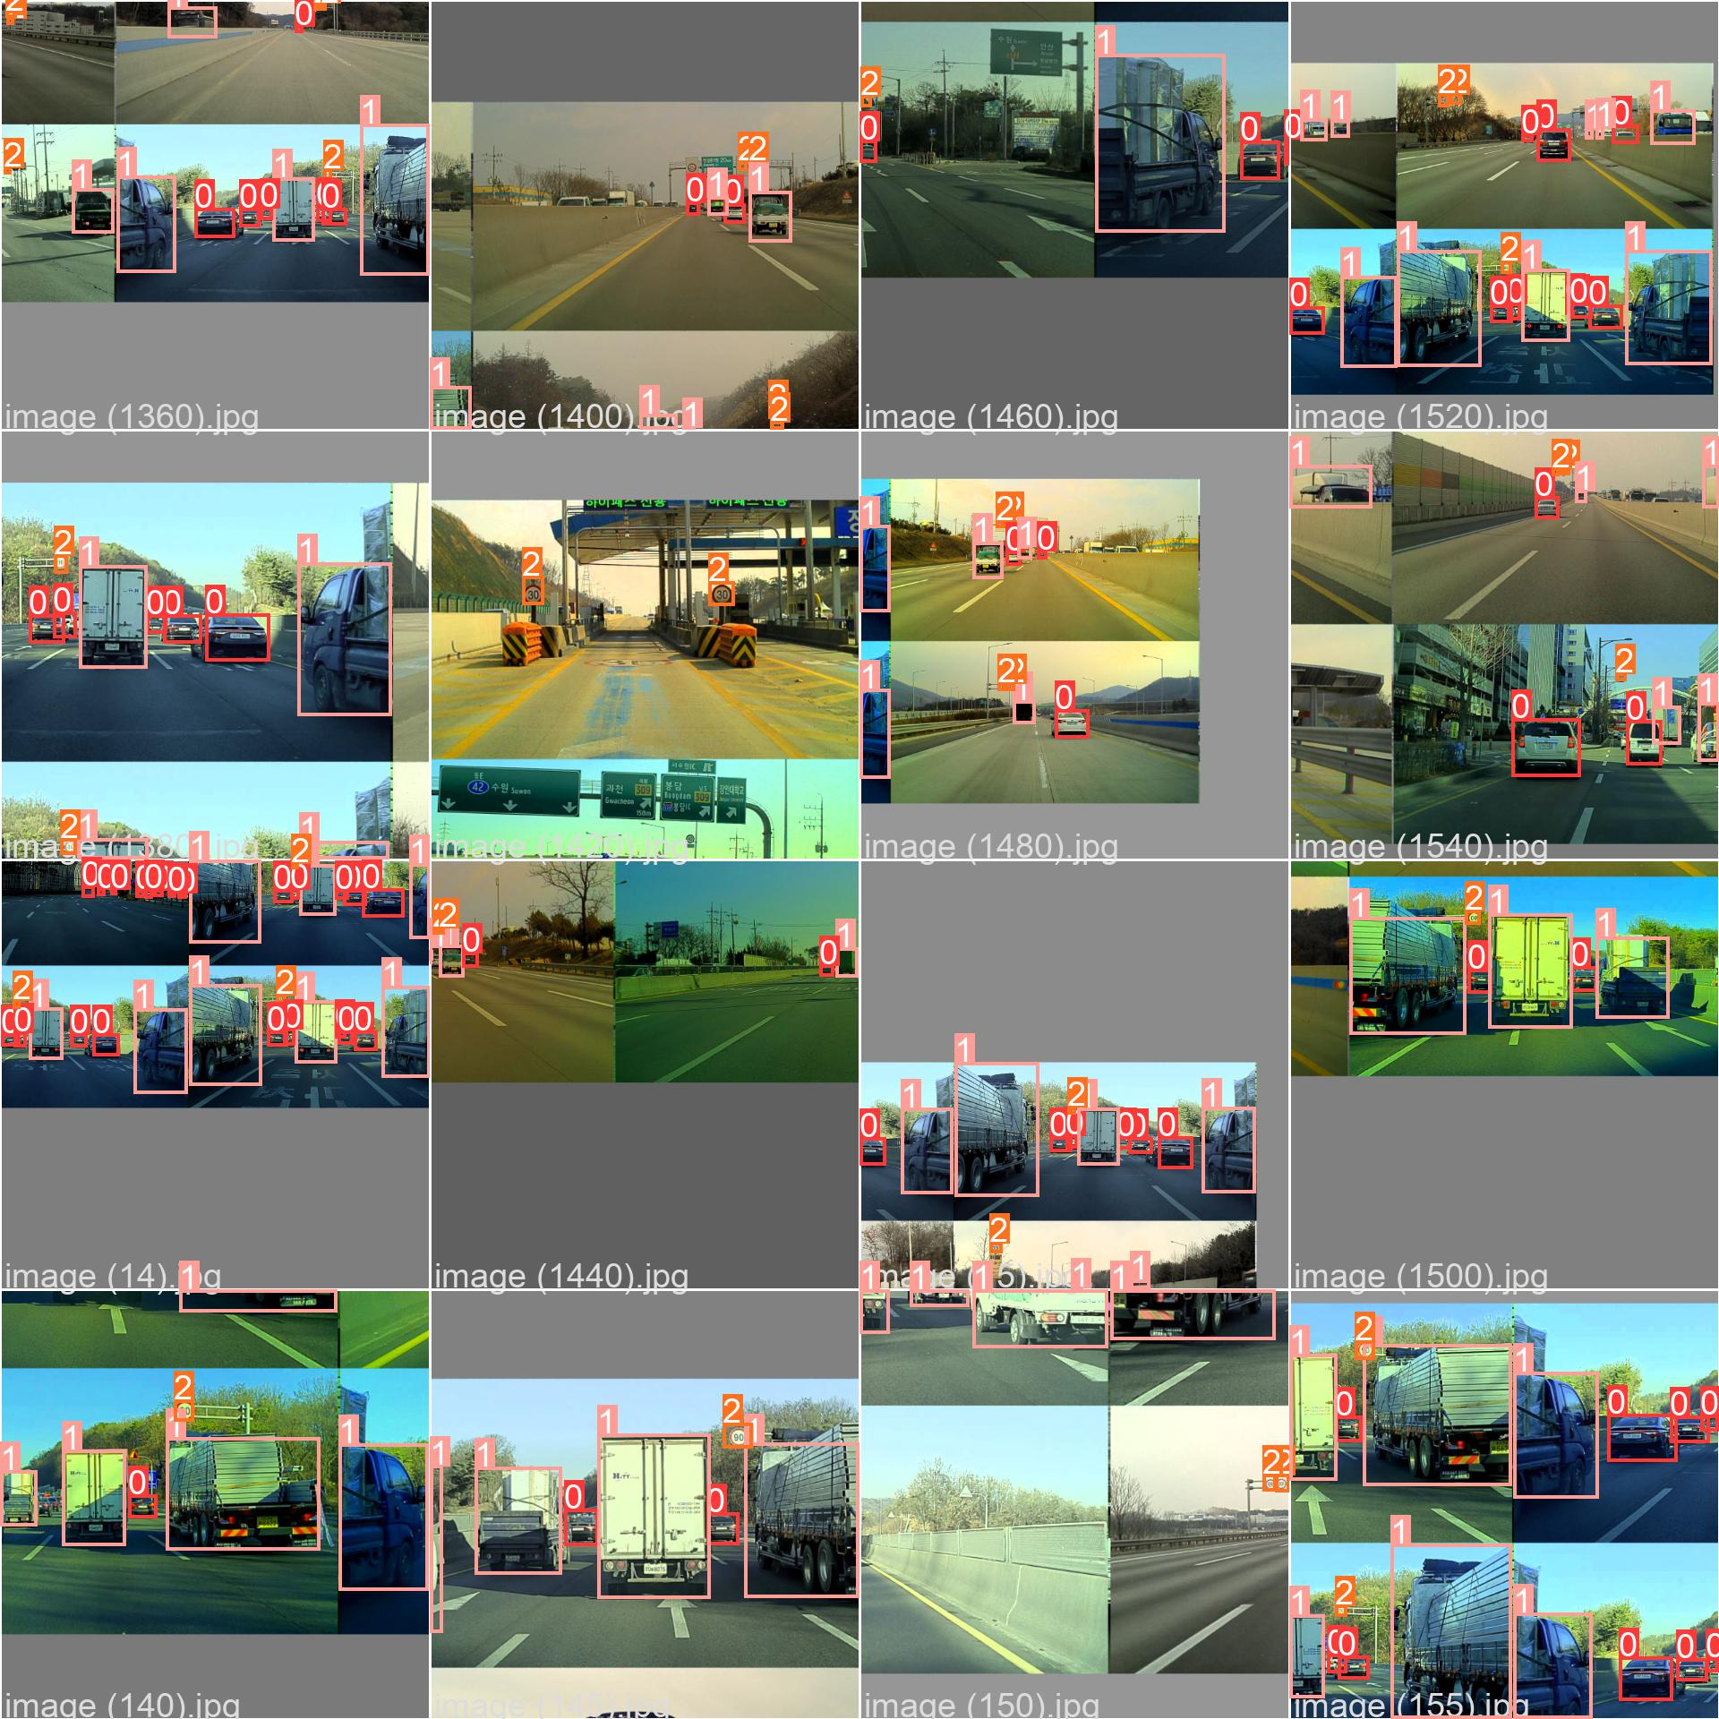
Train_batch2

Slide 18
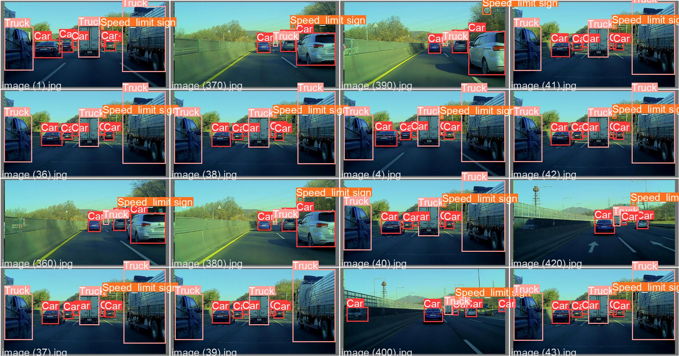
Val_batch0_labels

Slide 19
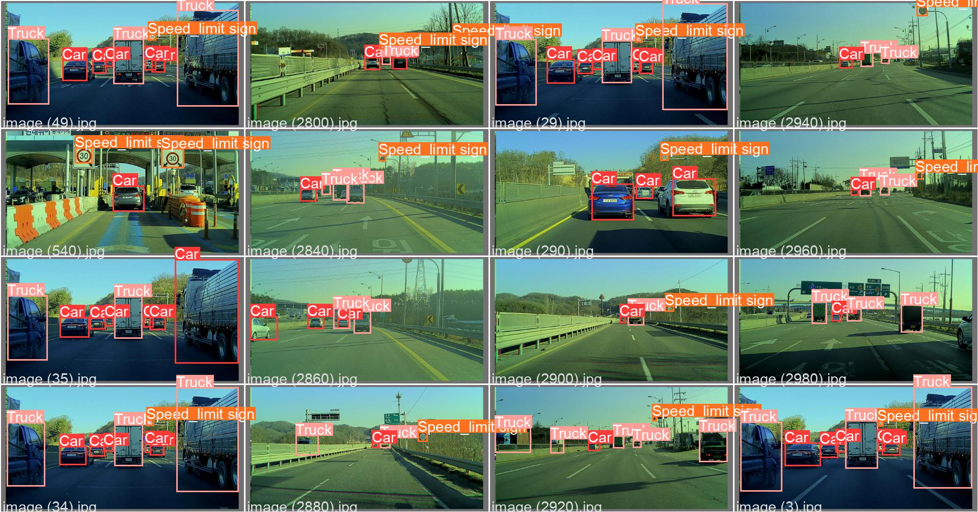
Val_batch1_labels

Slide 20
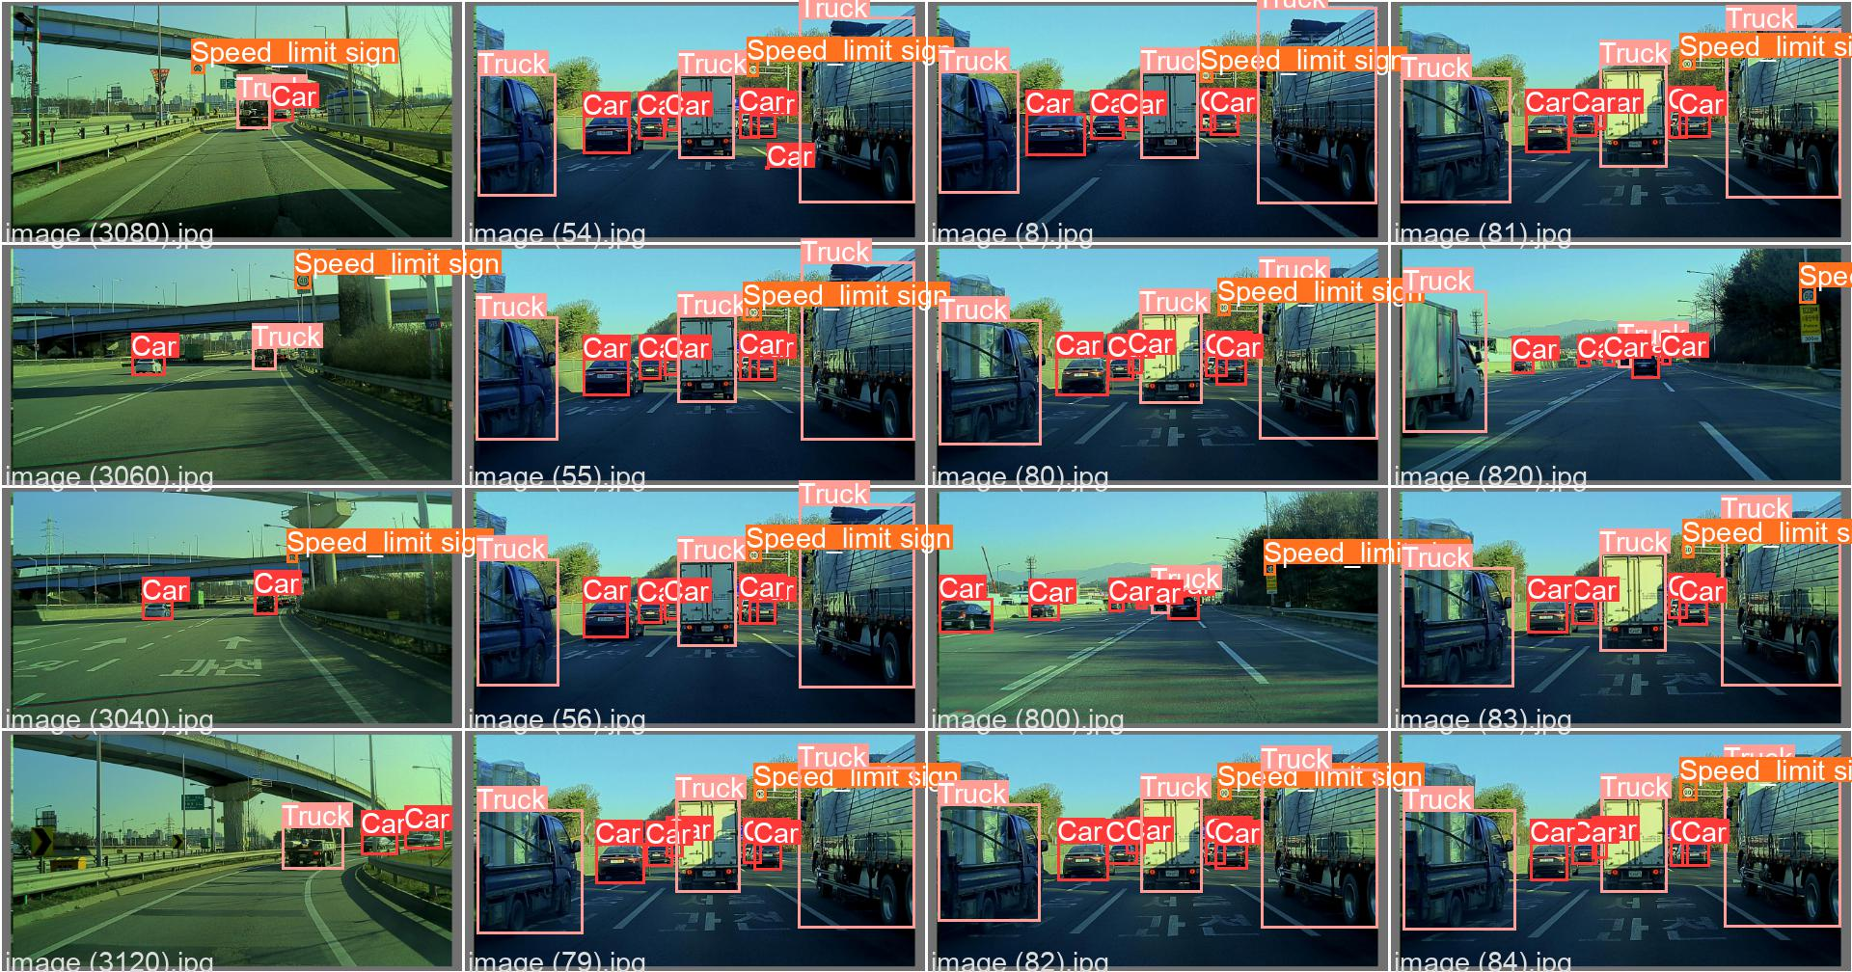
Val_batch2_labels

Slide 21
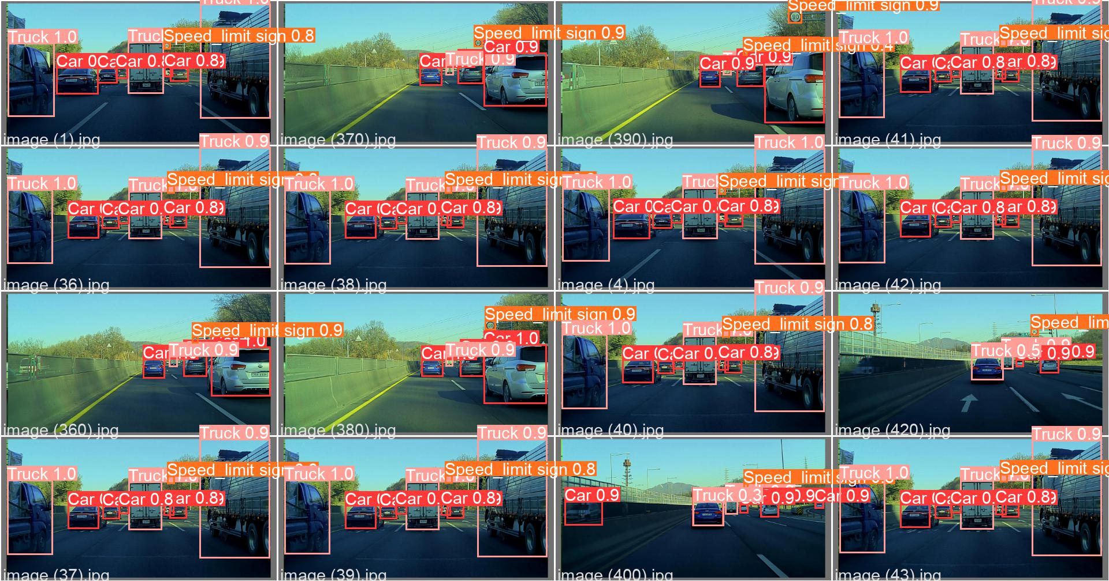
Val_batch0_prediction

Slide 22
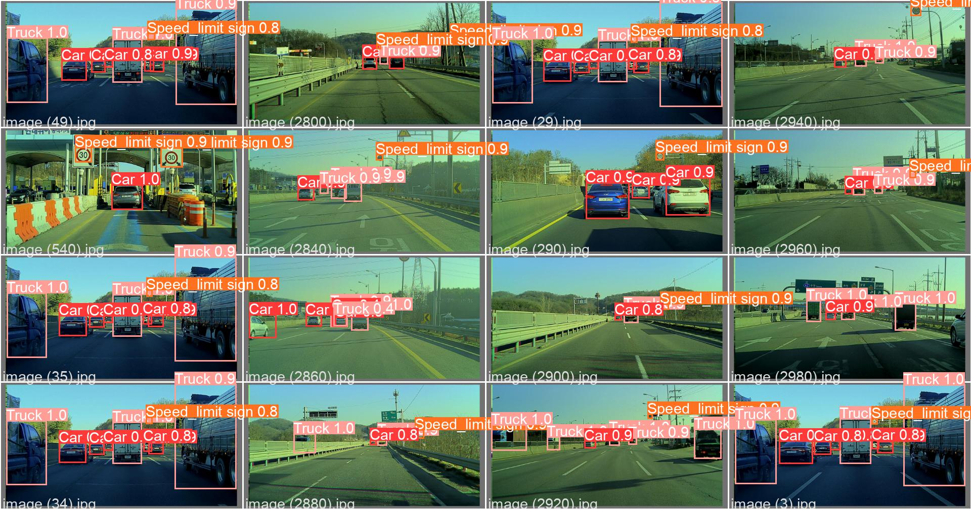
Val_batch1_prediction

Slide 23
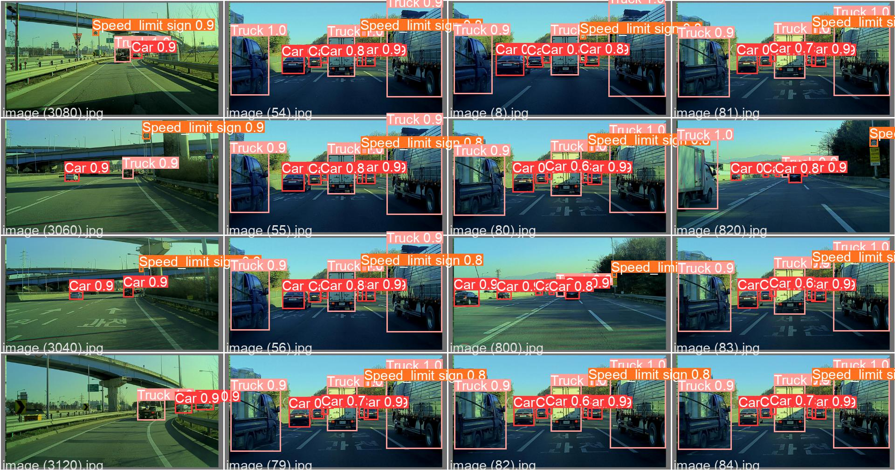
Val_batch2_prediction

Slide 24
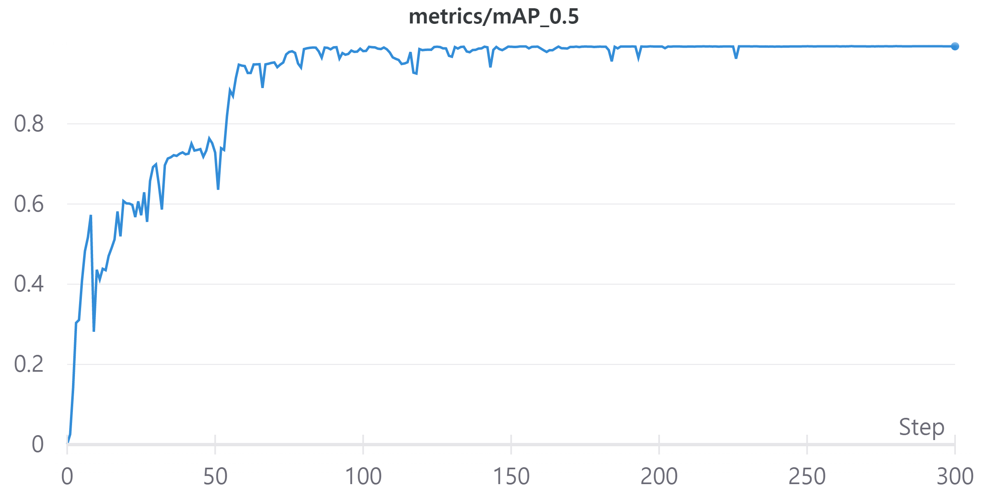
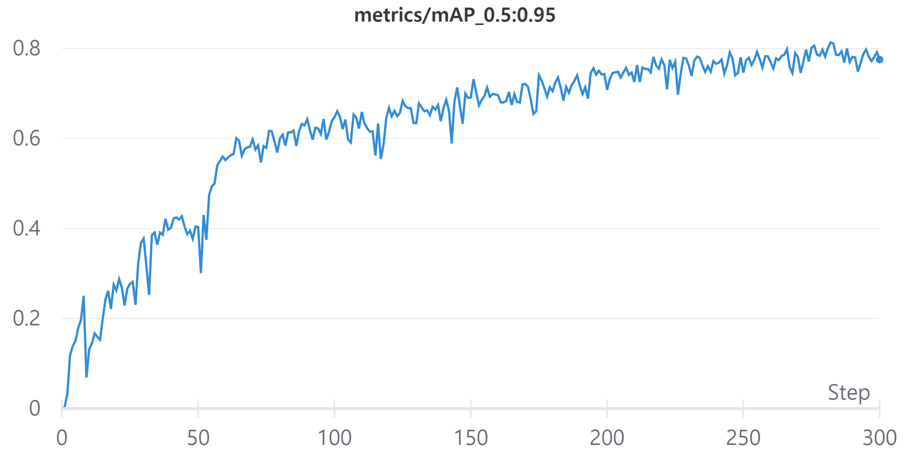
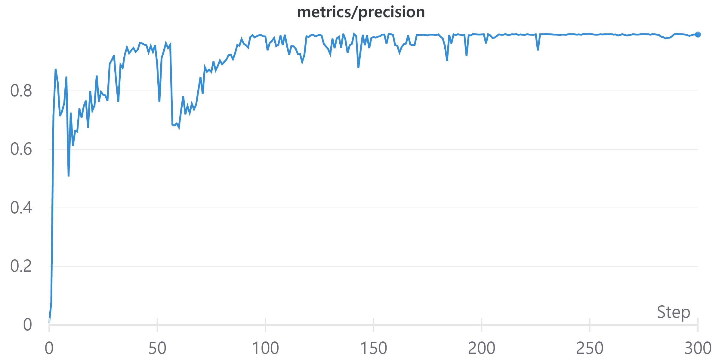
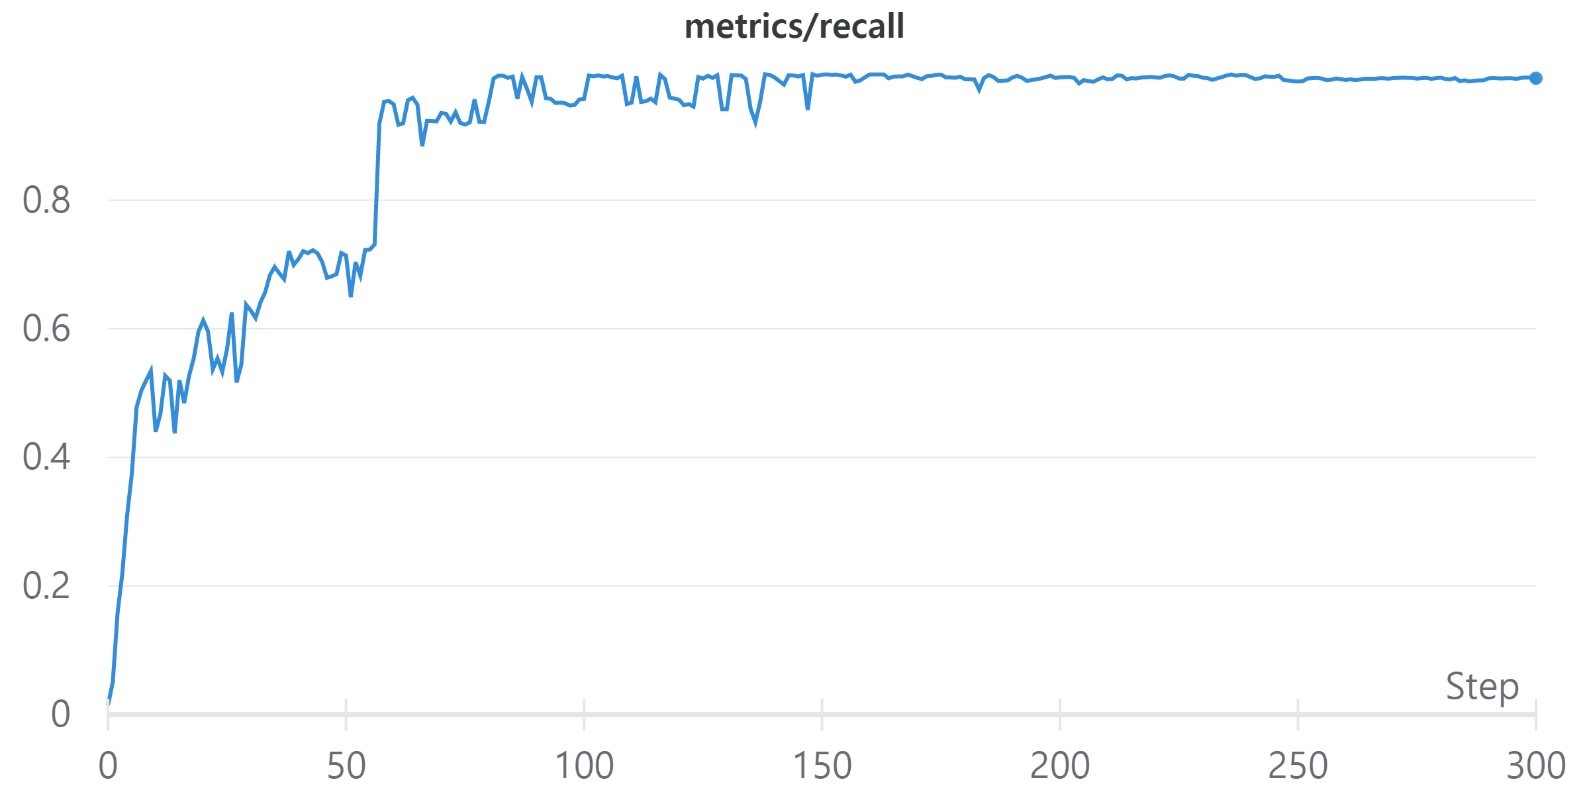
Metric_Graphs:

Slide 25
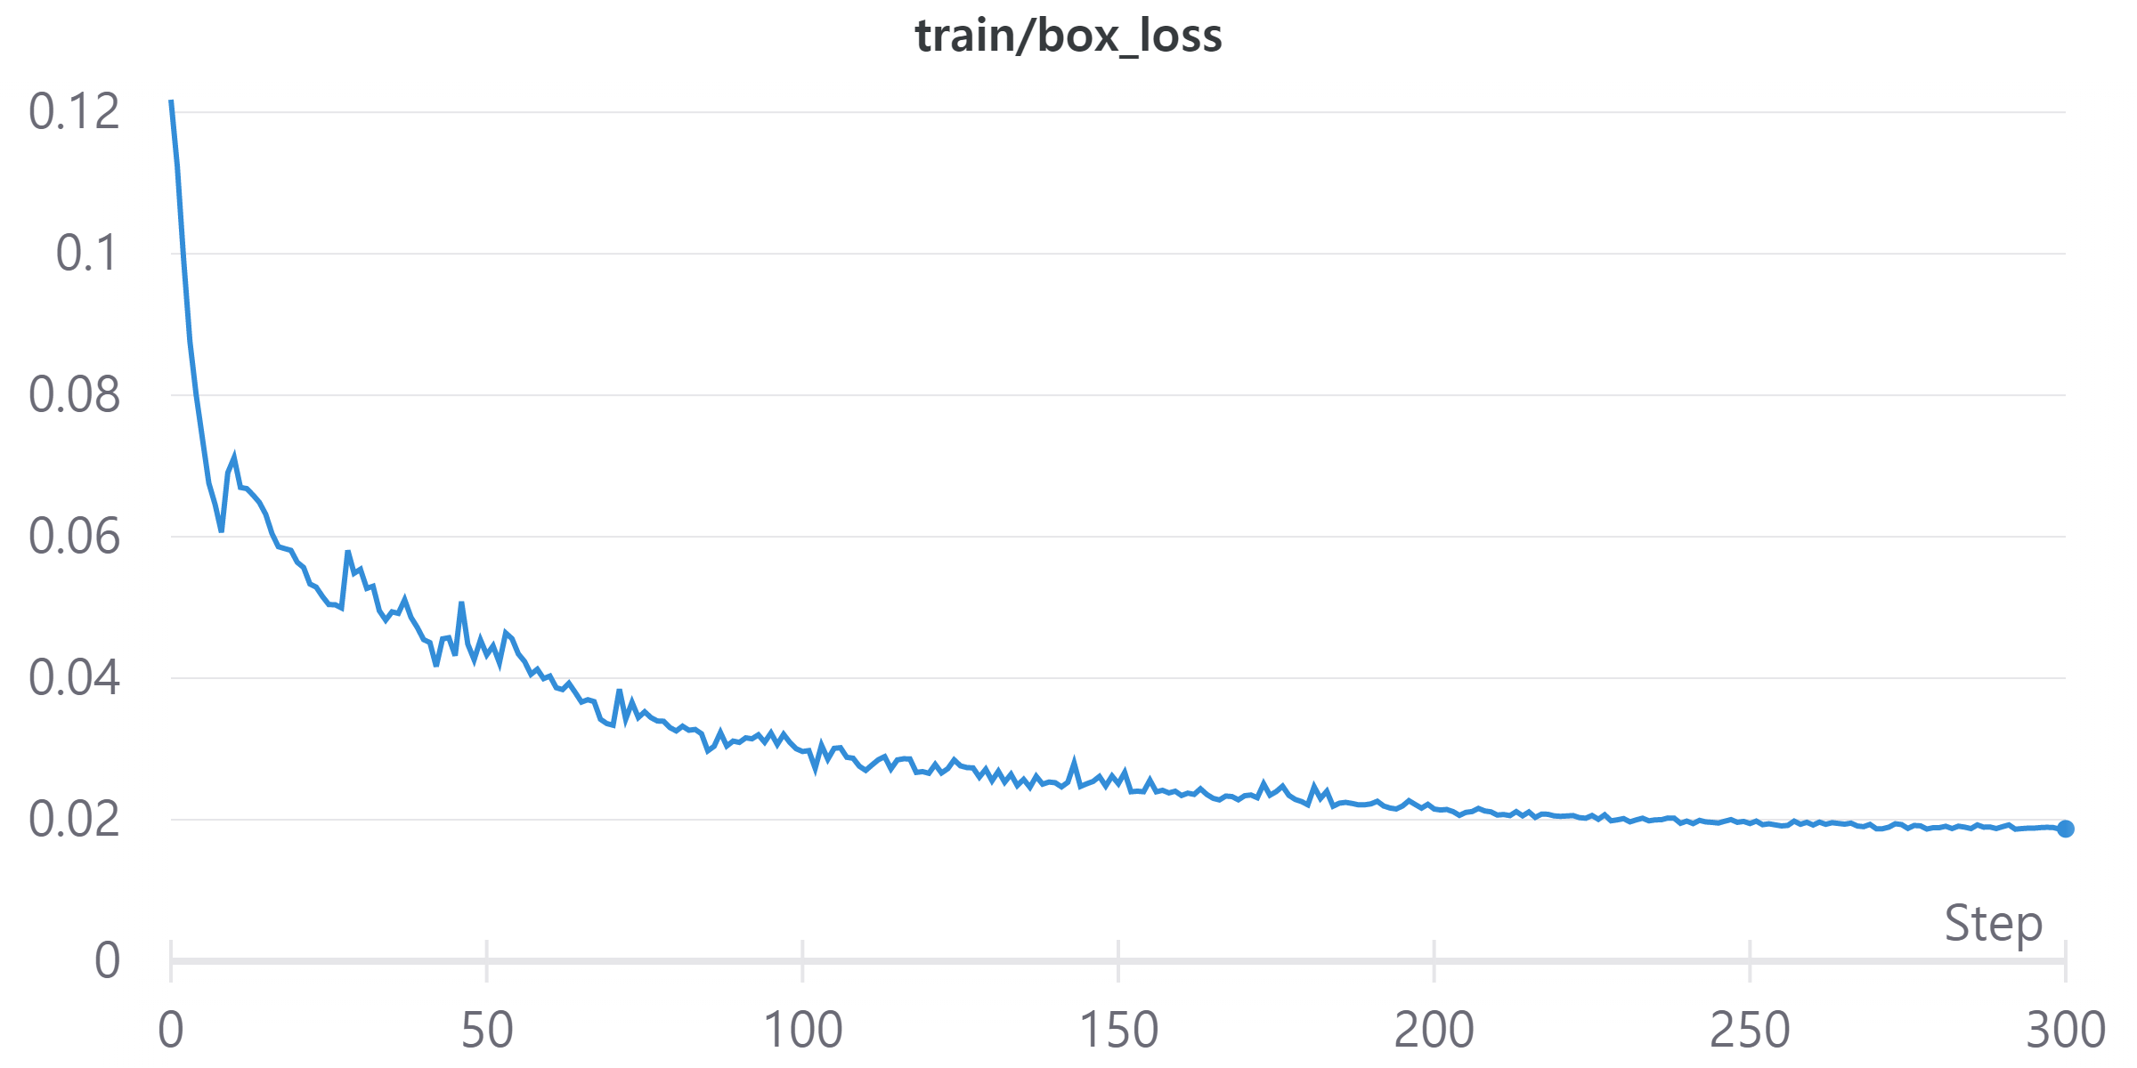
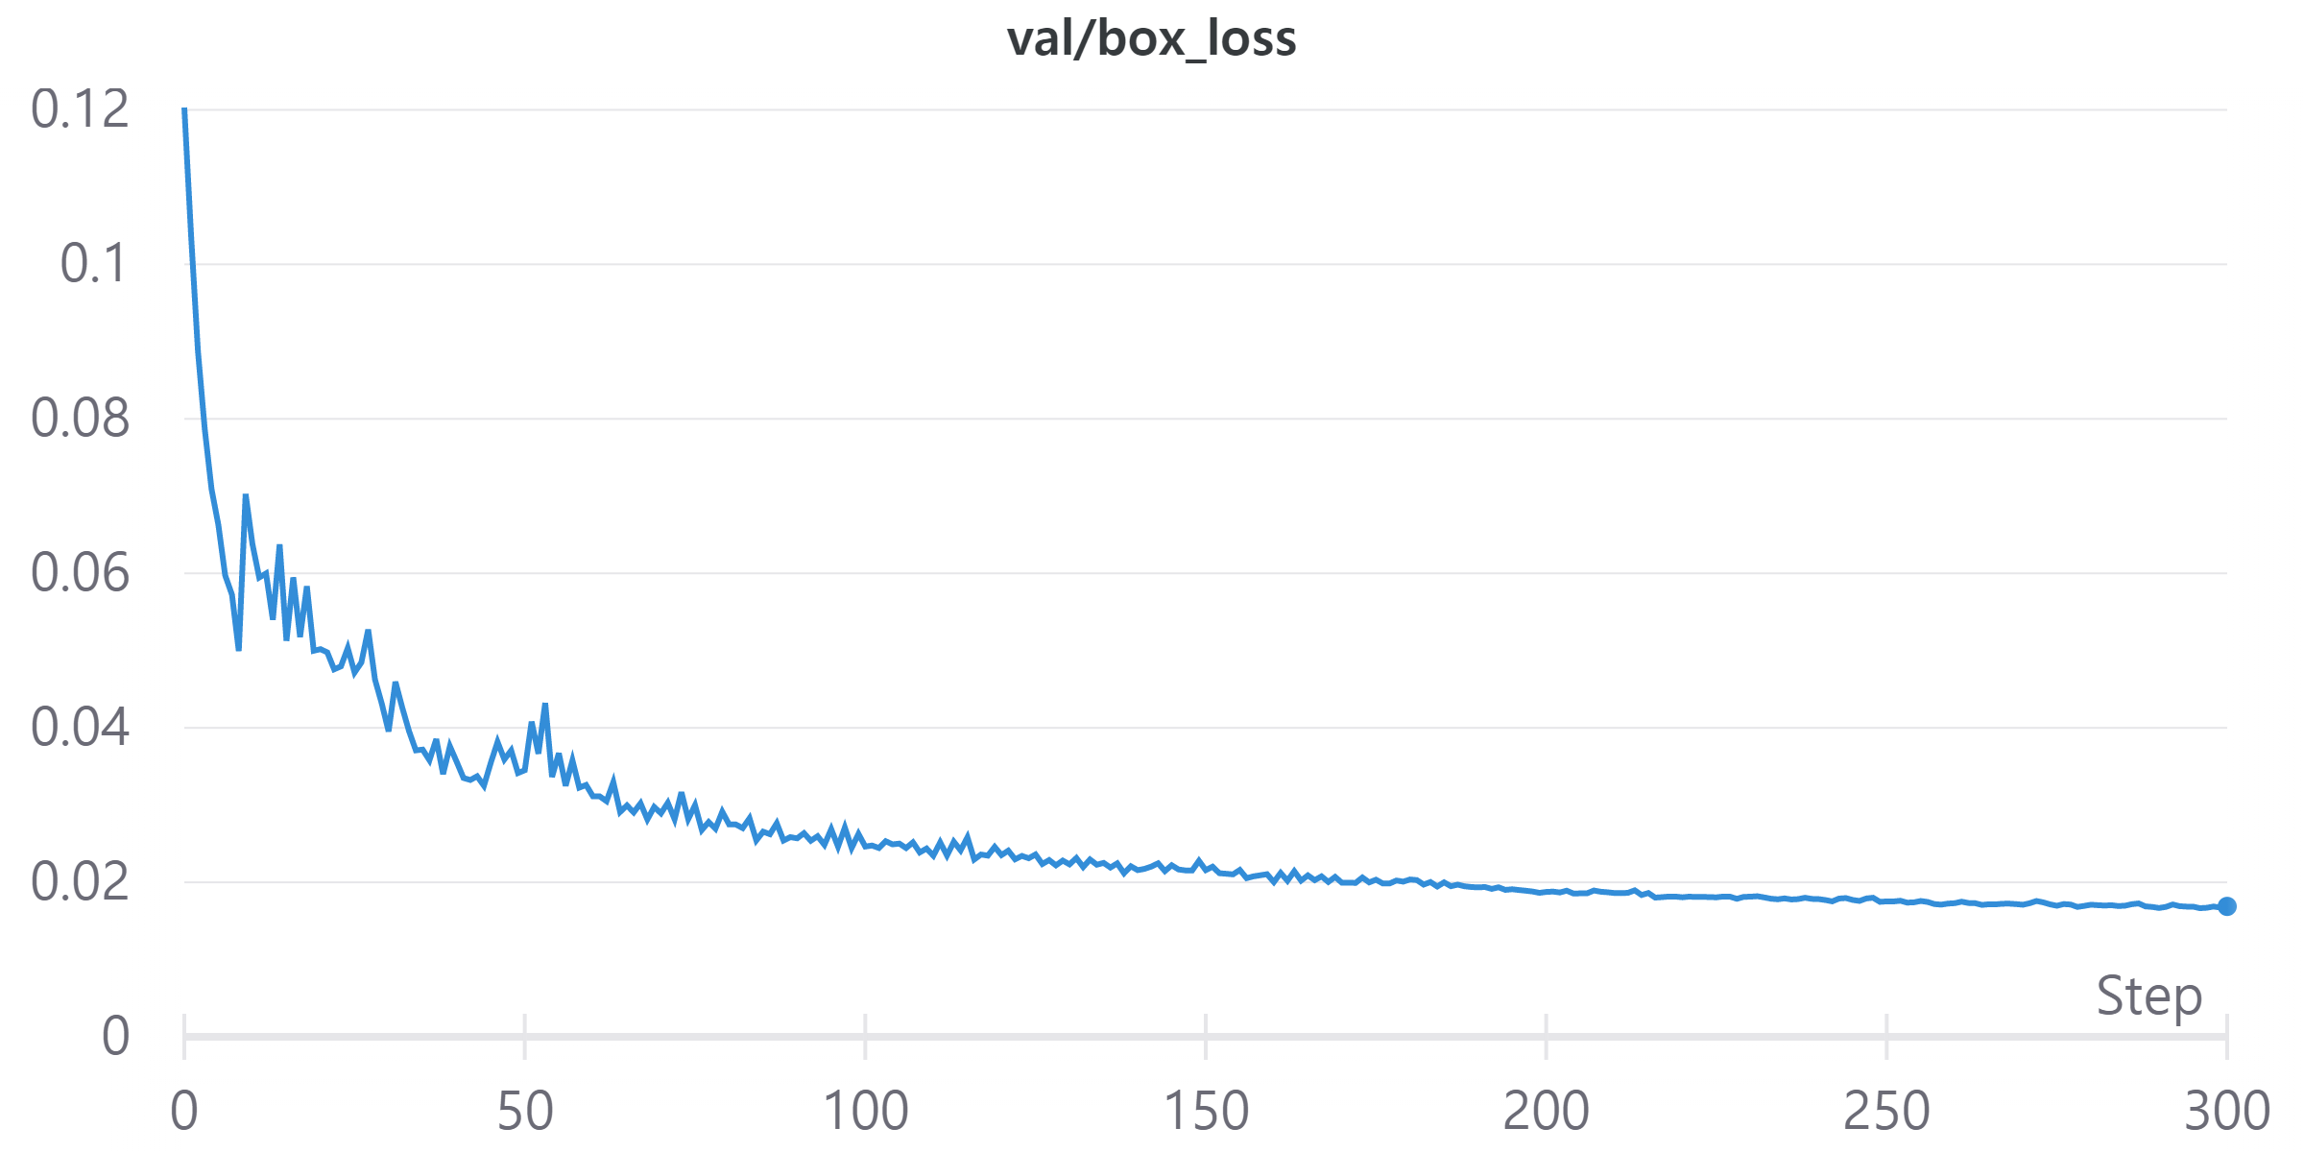
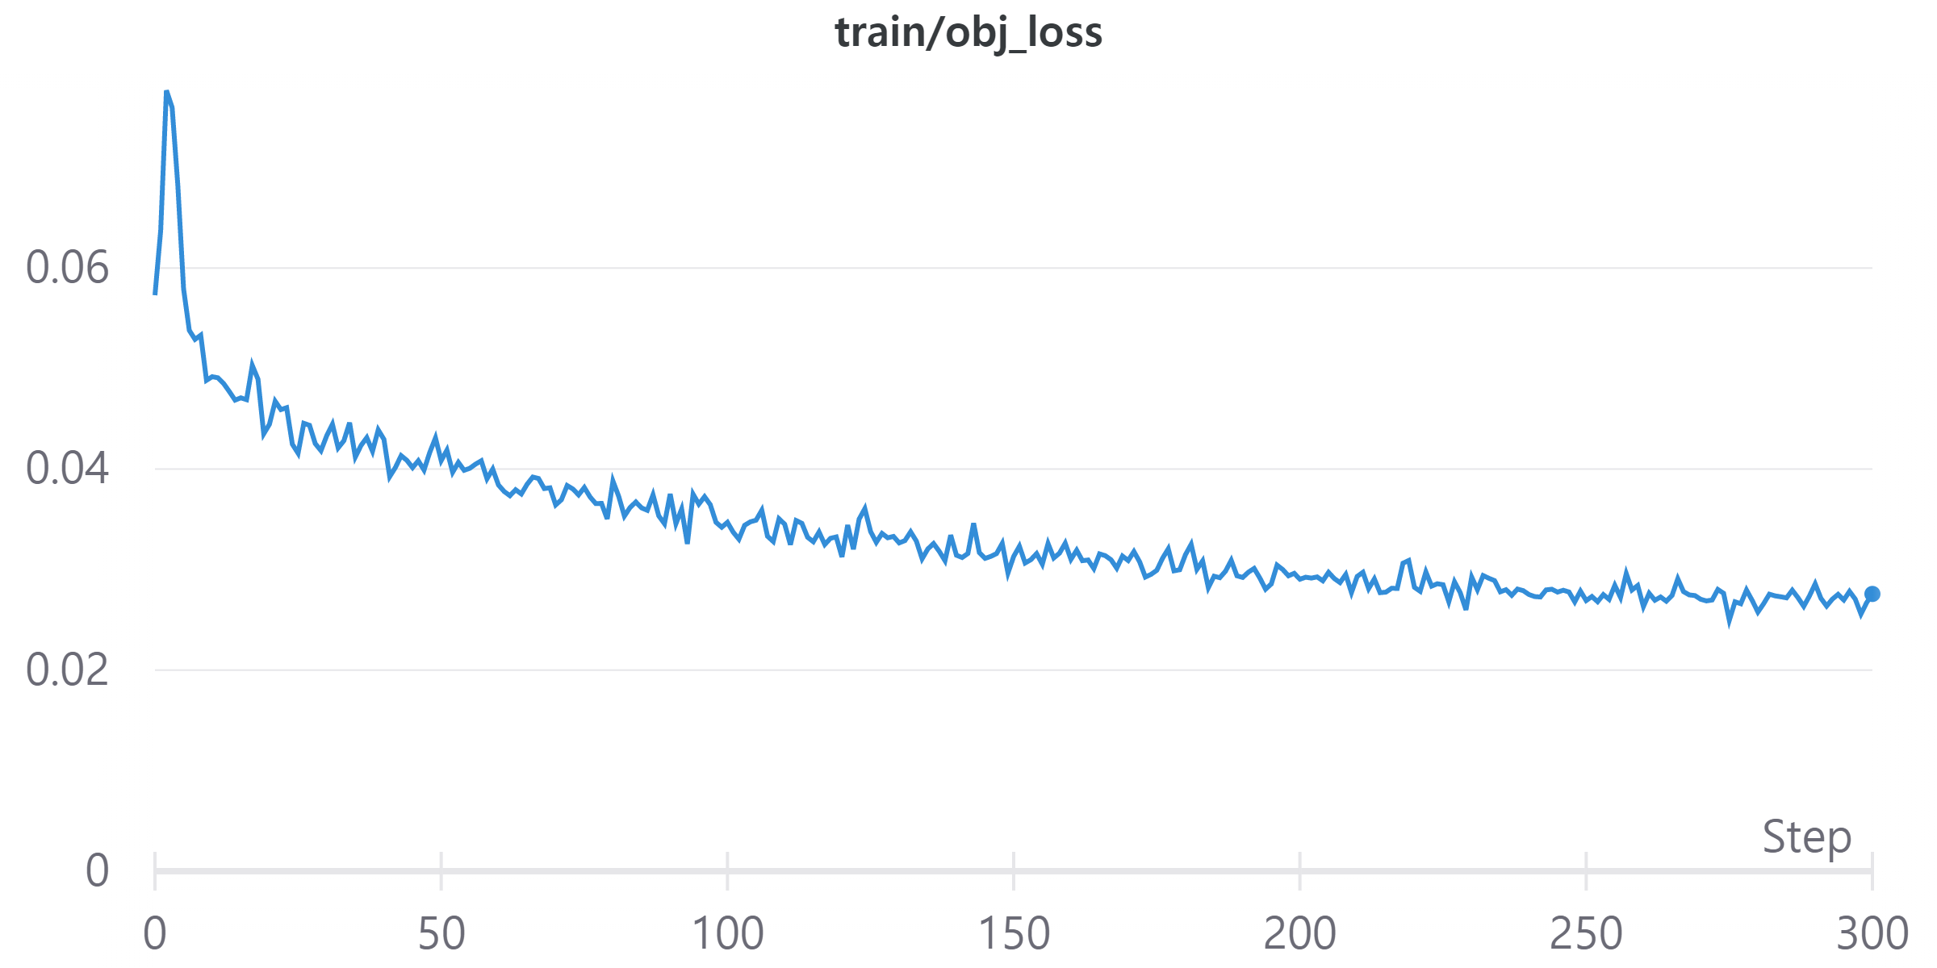
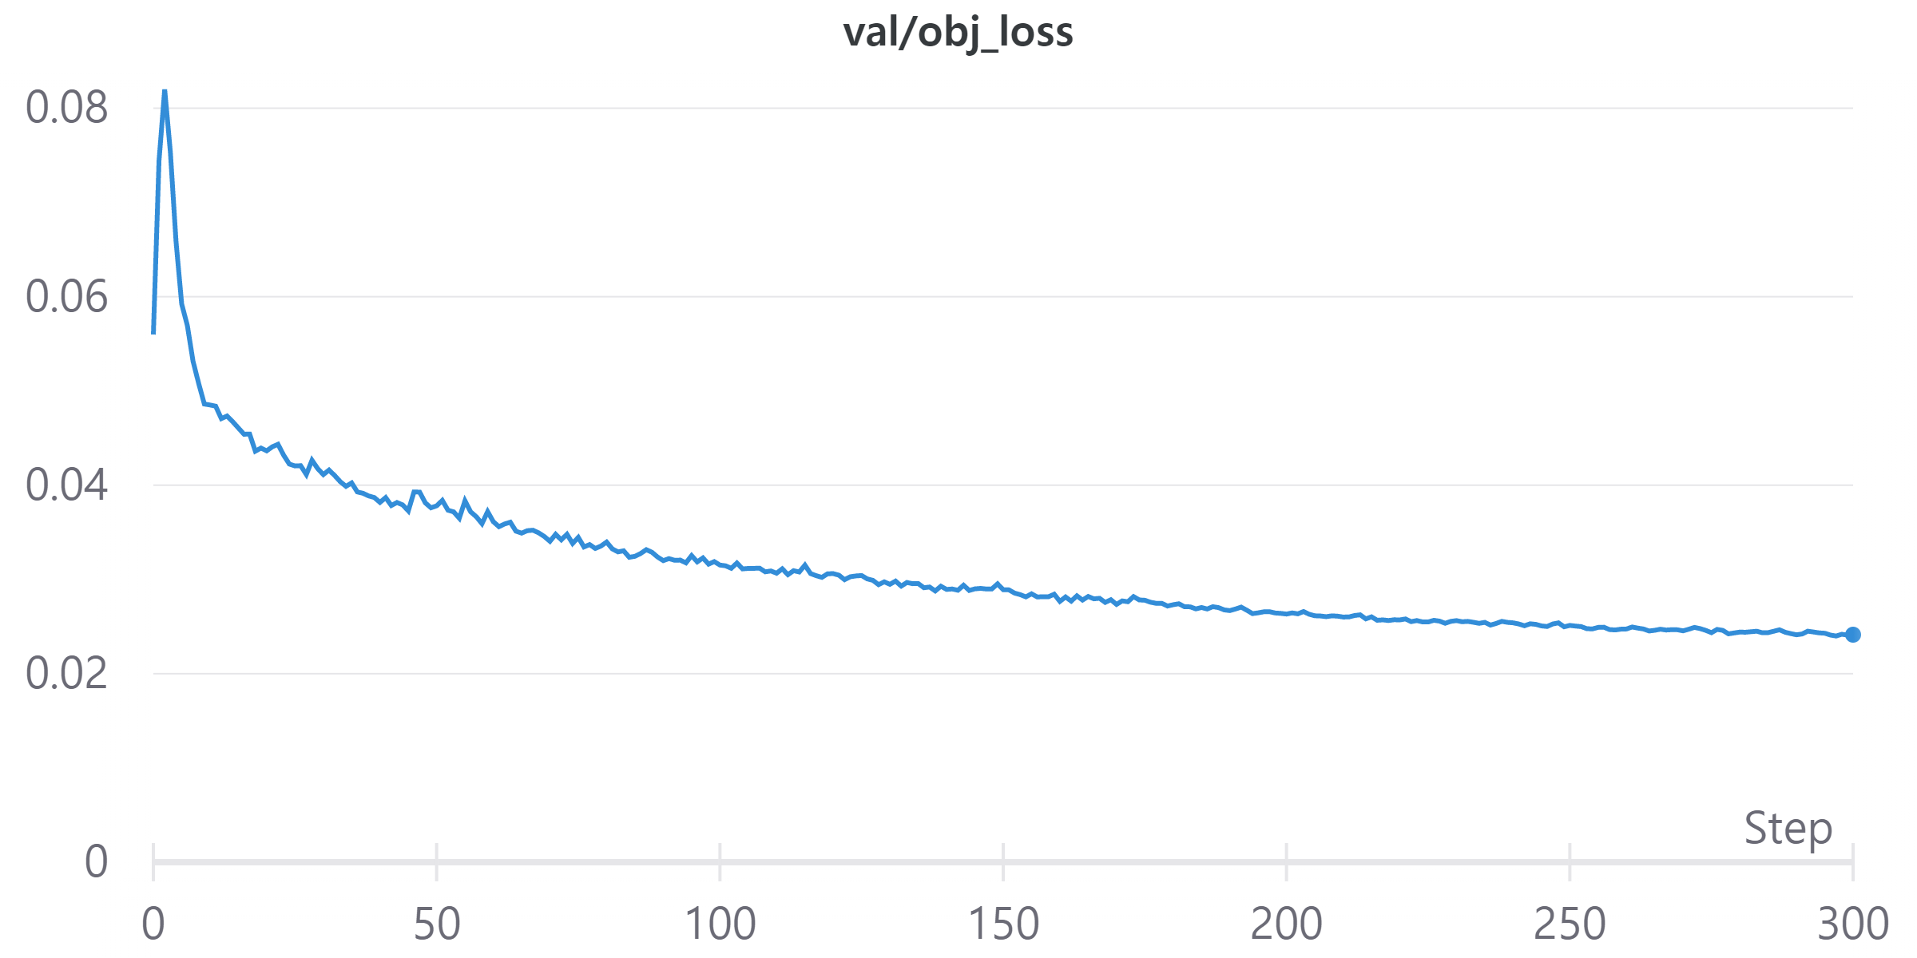
Metric_Graphs:

Slide 26
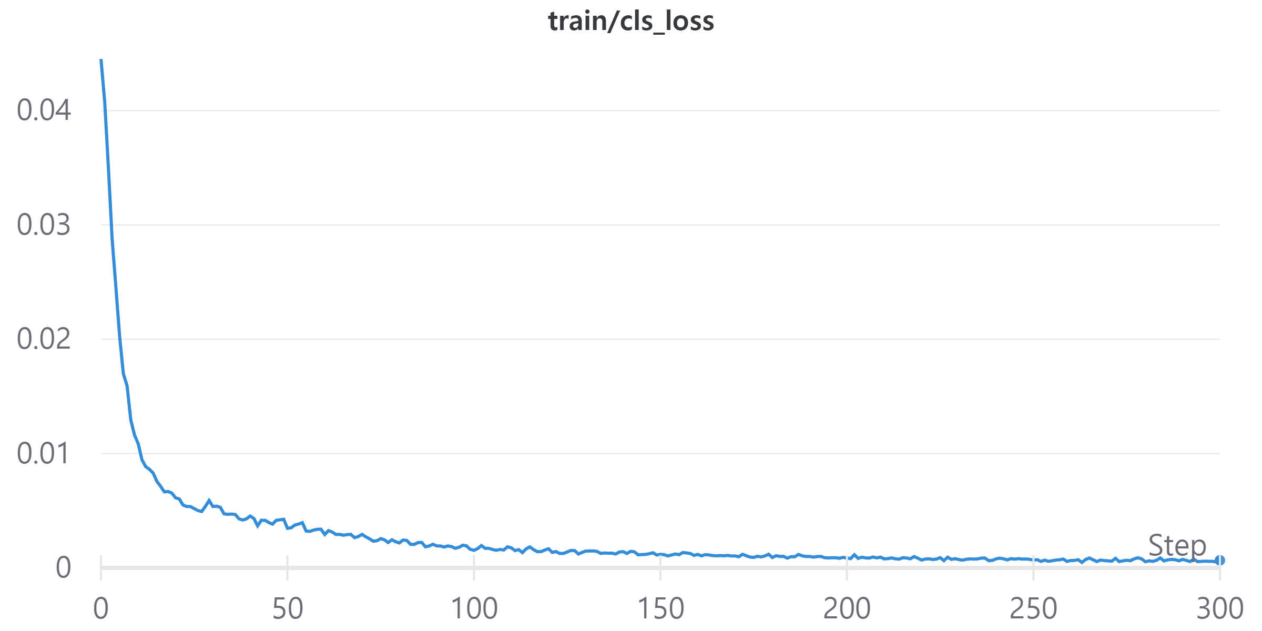
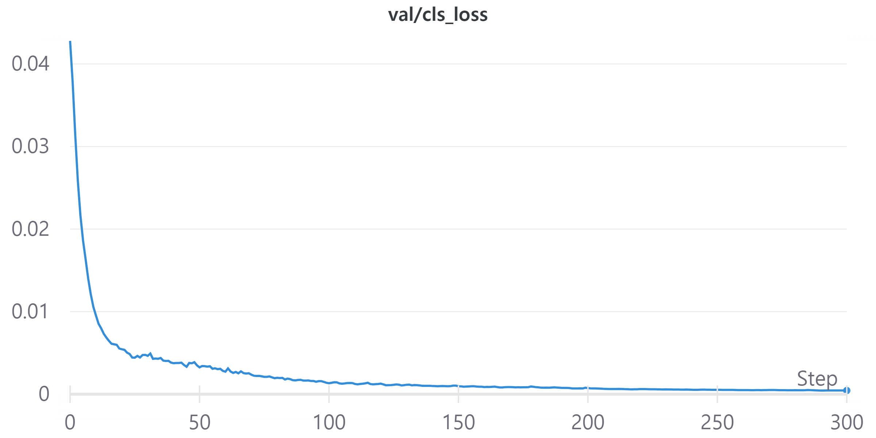
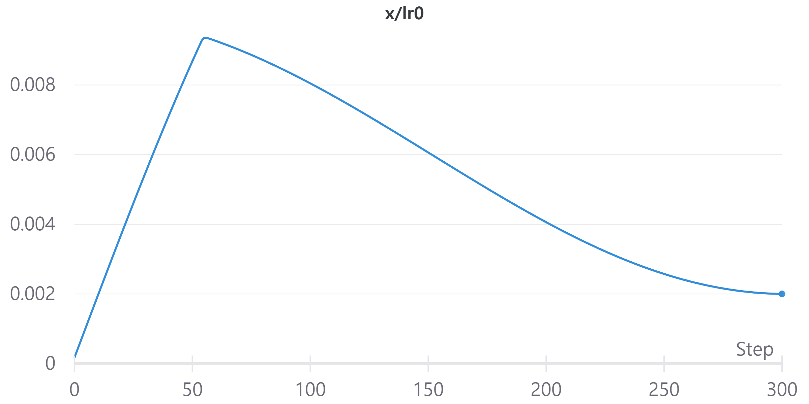


Slide 27
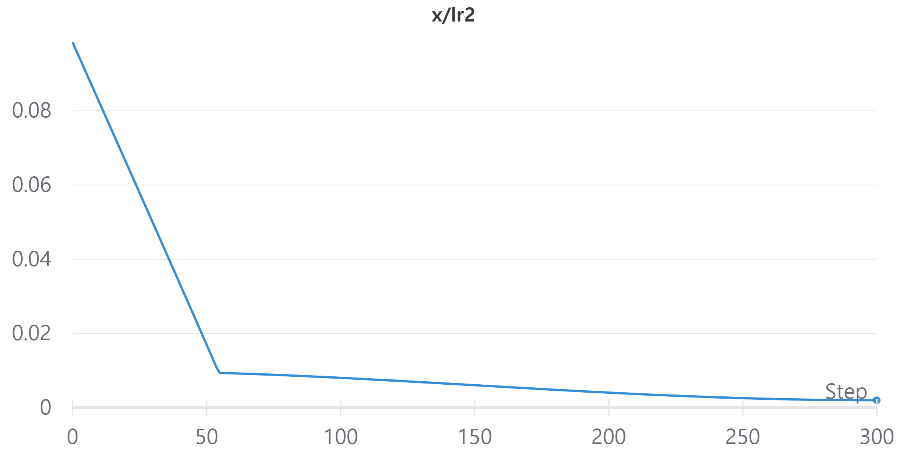

Slide 28
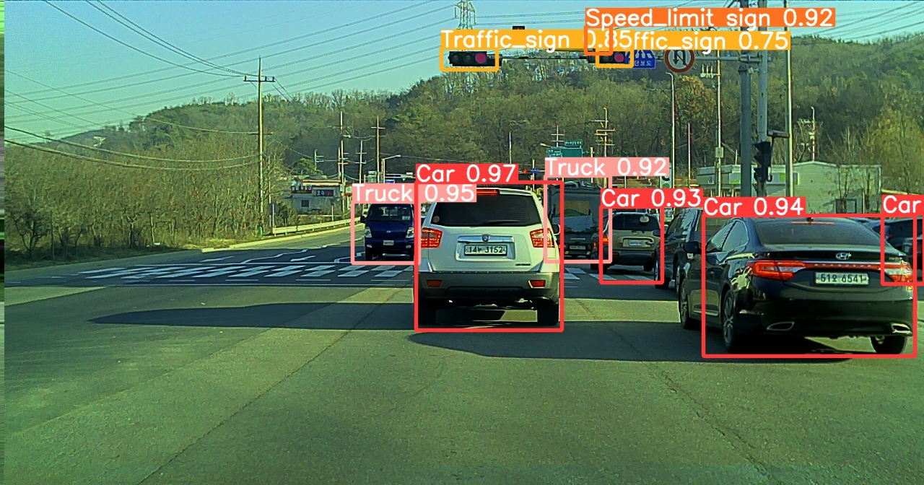
Object detection results:

Slide 29
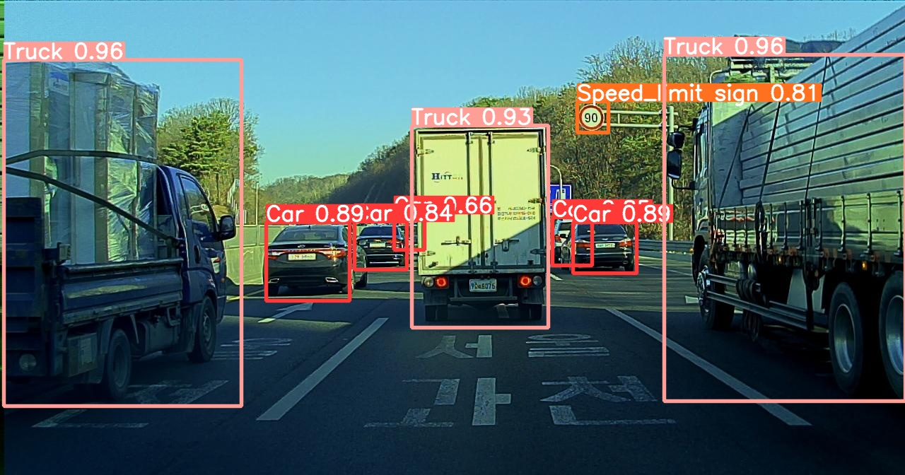

Slide 30
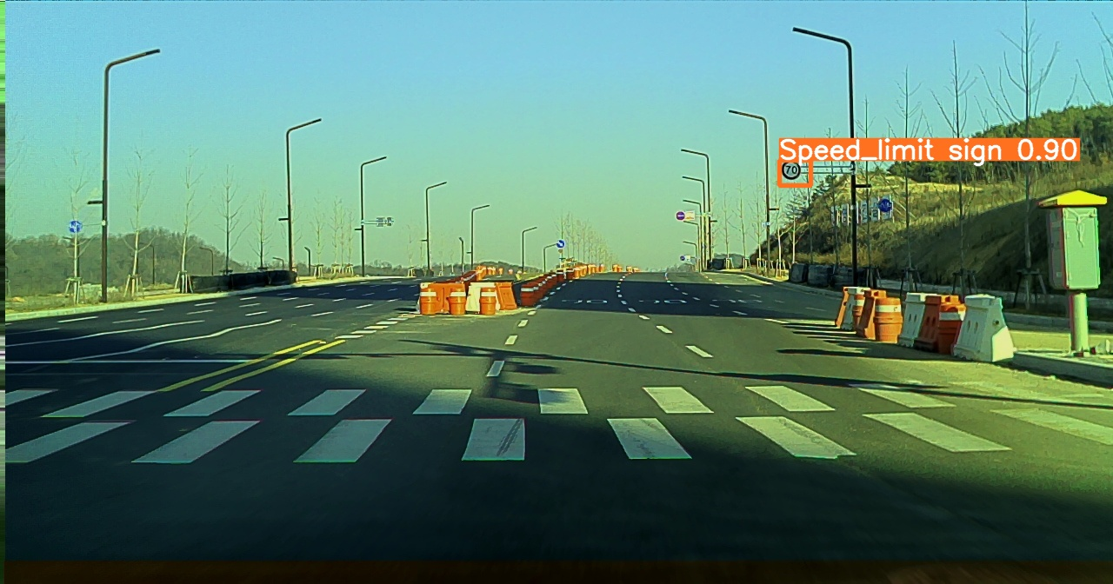

Slide 31
Thank You

